Slide 1
Databases and the Code First Approach
A psychotically fast crash course

Slide 2
About Me
SELU Graduate
Psychology
Computer Science
Work at Vinformatix
Software Developer
Project Manager
Agile Coach
Current Obsession
I-O Psychology

Slide 3


1. Data
Data is boiled down to facts related to an object. Examples of data are...
First name, last name, birthday, and favorite movie are all facts about you
CommentText, IsLiked, and CommentOrderPosition are all facts about a comment on FaceBook
Things such as is the user logged in or is this input valid are not examples of data but would live in business logic (where your “if” statements are, the actual code)

Slide 4
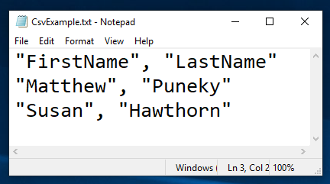
2. Databases
Data by itself is random. A database is an organization of data so it may be understandable and maintainable.
A Comma-Separated Values file (CSV) can be thought of as a database in a simple form.
You could parse through this data, treating each line as a row of data, and it will work okay, though slow.

Slide 5
3. DBMS
Database Management Systems (DBMS) are a collection of programs which allow users to access a database and change its data
There are many types of DBMS out there, such as Navigational, Relational, and Object Oriented. We will mainly be focusing on SQL Relational Databases for the code first approach
We will be using SQL Server Management Studio as our DBMS, I recommend you do as well

Slide 6
4. Relational DB
Relational databases work by relating tables of information to each other, using Primary Keys (PK) and Foreign Keys (FK) to link one column of data to another table.
Tables have rows and columns which work like an x, y coordinate to find data.
A column can be indexed, which means it is extremely fast to read from, but slow to write too. More on this later.
The language we will use to achieve this is called Structured Query Language (SQL)

Slide 7
5. SQL
SQL is used to insert, search (scan), update, and delete database records (rows). It has other uses, but for this class you will mainly focus on these abilities.
There are defined types in SQL which differ from the Object Oriented languages you use
VARCHAR(size) is like string, INTEGER is like int, DECIMAL(p,s) is high-precision numbers, TIMESTAMP is like DateTime.
For more types, visit: https://www.w3schools.com/sql/sql_datatypes.asp

Slide 8
6. Keys
Primary Keys define a unique identifier to a record. They are used by other tables to maintain relationships using Foreign Keys.
A Foreign Key is a reference to another tables Primary Key.
You use these relationships to keep data usage to a minimum. Instead of storing a user's name in every table, you can instead hold a reference to the users primary key in every table. This way, if you update the users name, you do not need to update every other table.
Examples...

Slide 9
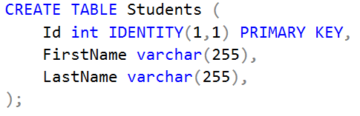
Creating a Students Table
Primary Key
(always unique)
Id | FirstName | LastName
1 | Matthew | Puneky
2 | Krystal | Richmond
... | ... | ...
28 | Charlie | Richmond
31 | Shelby | Cross

Slide 10
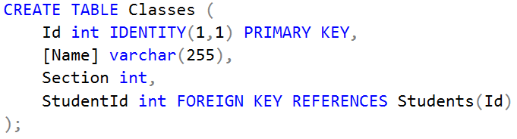
Creating a Classes Table
Id | Name | Section | StudentId
1 | CMPS 285 | 01 | 1
2 | CMPS 285 | 01 | 2
... | ... | ...
44 | CMPS 290 | 01 | 1

Slide 11
Creating a Classes Table
 | Id | Name | Section | StudentId
1 | 1 | CMPS 285 | 01 | 1
2 | 2 | CMPS 290 | 01 | 2
... | ... | ... | ...
57 | 44 | CMPS 290 | 01 | 1
Using Foreign Keys
What if you needed to add another column?
 | Id | Name | Section | FirstName | LastName
1 | 1 | CMPS 285 | 01 | Matthew | Puneky
2 | 2 | CMPS 285 | 01 | Krystal | Richmond
... | ... | ... | ...
57 | 44 | CMPS 290 | 01 | Matthew | Puneky
Not Using
Foreign Keys

Slide 12
7. Relationships
One-to-Many: A single record in one table is referenced (using its primary key) in another table zero, one, or many times. This is like the previous example where a single user can be in classes table many times.
Many-to-Many: Many records in one table can relate to many records in another table. We will edit the previous tables to be Many-to-Many.
One-to-One: A single record in one table references a single record in another table. Students to PhoneNumbers could be like this. Can be useful when you want to minimize table sizes.
Notes:
One-To-Many: One manufacturer can make many models of cars, but each model of car only has one manufacturer

Slide 13

Editing Classes Table
 | Id | Name | Section
1 | 1 | CMPS 285 | 01
2 | 2 | CMPS 285 | 01
... | ... | ... | ...
57 | 44 | CMPS 290 | 01

Slide 14
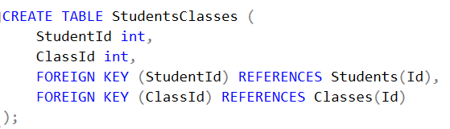
Creating a Link Table (many-to-many)
 | StudentId | ClassId
1 | 1 | 1
2 | 2 | 44
... | ... | ...
57 | 1 | 44

Slide 15
The Current State of the Database
Students Table
Classes Table
StudentsClasses Table
Id | FirstName | LastName
1 | Matthew | Puneky
2 | Krystal | Richmond
... | ... | ...
28 | Charlie | Richmond
31 | Shelby | Cross
StudentId | ClassId
1 | 1
2 | 44
... | ...
1 | 44
Id | Name | Section
1 | CMPS 285 | 01
2 | CMPS 285 | 01
... | ... | ...
44 | CMPS 290 | 01

Slide 16
8. Entity Framework
It is hard to keep your SQL database in line with the models in your code. Entity framework fixes this issue.
You create entity classes in your code, and when following certain rules, a database table will be generated from that code.
You can define relationships between tables, apply indexes, add/drop columns, etc., all from code.
The process of setting this up is complicated, so we will go through it step by step a few times.

Slide 17
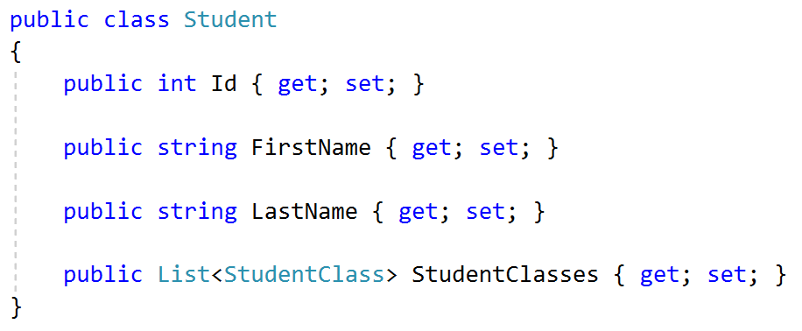
Student Entity
“int Id” will automatically map as the primary key
List<StudentClass> marks this entity as having a many relationship with StudentClass. Depending on how the StudentClass is setup will determine if it is a many-to-many or many-to-one

Slide 18
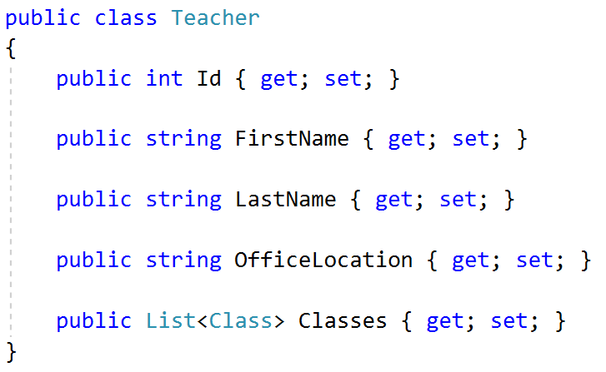
Teacher Entity

Slide 19
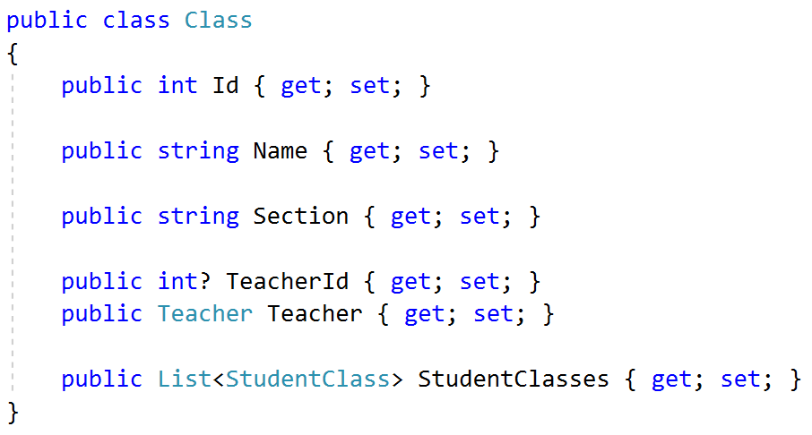
Class Entity
Teacher + TeacherId creates the Foreign Key relationship between Class and Teacher
Teacher property marks this entity as having a “one-” relationship to Teacher. It could be one-to-many or one-to-one.
TeacherId is set to a nullable int (the ? makes the int a nullable int). This tells entity framework that the Teacher relationship is optional. Thus, a class can exist without a teacher being associated to it.

Slide 20
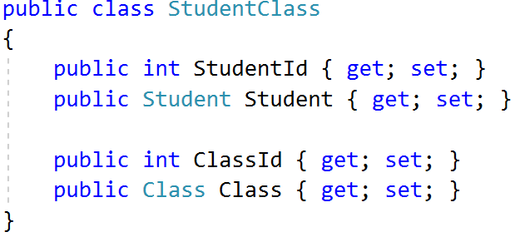
StudentClass Entity
This is a linking table, or a Many-to-Many table.
Student + StudentId creates a Foreign Key relationship between StudentClass and Student
Class + ClassId creates a Foreign Key relationship between StudentClass and Class
A linking table joins two one-to-many relationships, allowing for many-to-many relationships.

Slide 21
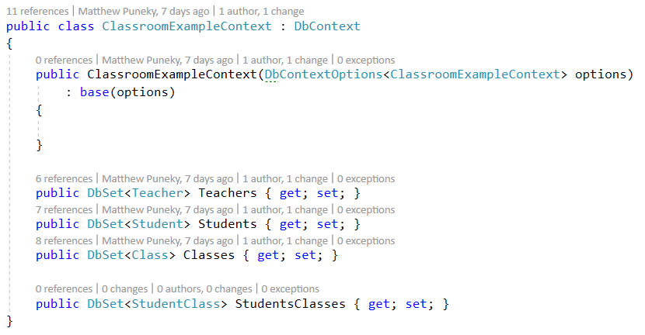
Implementing Your Database Context
Do not forget to implement DbContext
For each class you made with the intention of being a database table, add them here. Name them in their plural format.

Slide 22
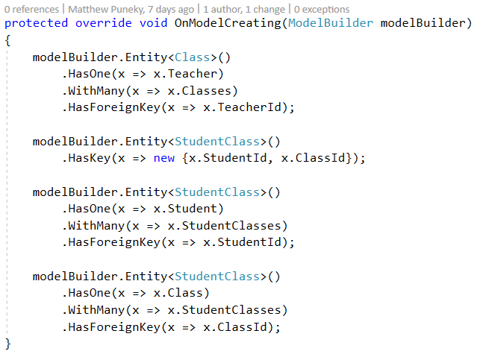
Building Relationships
If you are using EF6 then you do not need to wire up relationships. If you are using Core, you will.
Model Builders live inside of your DataContext.
Breakdown of the first builder. The entity class has a relationship with a single teacher and that teacher has a relationship with many classes using the TeacherId. Thus there is a one to many relationship between teacher and class.

Slide 23
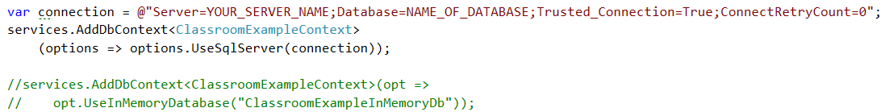
Registering Your Data Context
Put this in Startup.cs, in the ConfigureServices(IServiceCollection services) method.
In the connection string, next to Server=, you put the name of your server. For many instances, this will either be “localhost\SQLEXPRESS” or simply “localhost”. If you have any issue with this, contact me and we can work through the server name issue.
If you cannot get the database working, you can use the commented out code instead. This will create an in memory database, circumventing the need for a server. All information will be deleted after you stop your project though.

Slide 24
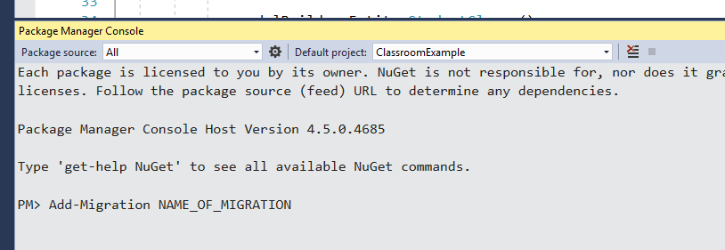
Adding Your First Migration
Go to Tools => NuGet Package Manager => Package Manager Console
Type “Add-Migration” followed by what you want to name the migration. Usually I name my migrations with Action_TableIAmDoingAndActionOn_ColumnsIAmDoingAnActionOn. Example: Update_StudentTable_DropClassIdColumn
When you add a migration, it will create a class that will explain how it is changing your database from the old way to the new way. You will do this every time you change your data structures. If you add a new entity, you need to add a new migration.

Slide 25
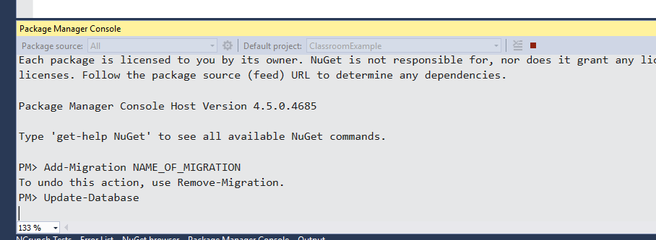
Updating Your Database
Adding a migration will create the “Up” and “Down” methods in the migration class. If the changes look correct, when you type “update-database”, it will apply the “Up” changes to your real SQL database.
If you do not do this, Entity Framework will attempt to communicate with the database, but they will not share the same schema. If you made a migration to add a new column, EF will say you can change it’s value, but it will fail when it tries to apply the changes to the database.

Slide 26
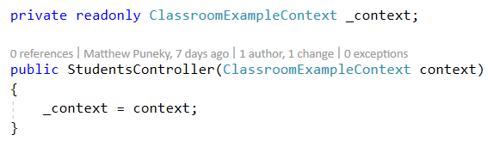
Using the Data Context
Using injection, you can bring the context into any class. The easiest place to bring in the context is through your controller's constructor. In the background, it will get an instance of your DataContext and inject it into the controller. There are more advanced ways to get the context, but we will not cover that here.
You can pass your context from your controller into lower repository classes if you wish. It is recommended that you inject the context into the lower classes, but do not worry too much about that in 285.

Slide 27
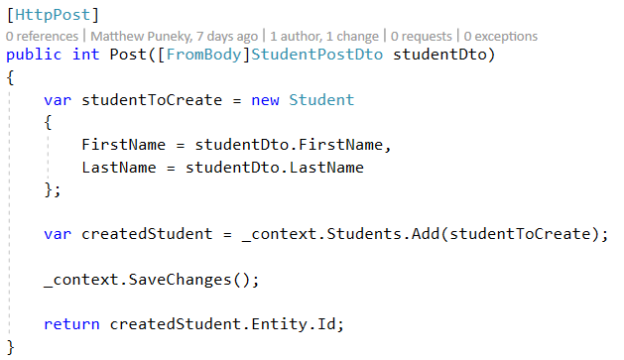
Using the Data Context
When you access the context, you will be able to select the tables you have made. If your table is not showing up, make sure you added the DbSet for that table to the data context.
Whenever you make a change in the database, make sure you call SaveChanges on your context.

Slide 28
Questions?

Slide 29
Resources
My repository for this presentation. It contains the project that generated the code for the slides.
https://github.com/MatthewPuneky/CodeFirstExample
W3Schools is a great place to learn about databases and SQL code
https://www.w3schools.com/
This is a general guide on how to setup a code first database with EF Core 2.1
https://docs.microsoft.com/en-us/ef/core/get-started/aspnetcore/new-db?tabs=visual-studio

